Slide 1
Interview Questions
By Israel Trusdell

Slide 2
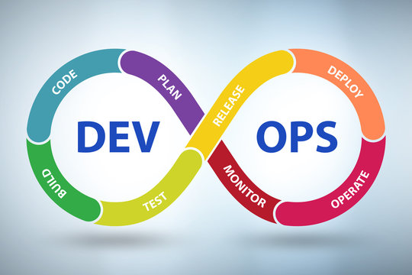
Question 1
Can you explain your understanding of DevOps and how it differs from traditional software development methodologies?

Slide 3
Question 1: Answer
DevOps is a software development approach that emphasizes collaboration, communication, and integration between software developers and IT operations teams. It aims to shorten the development life cycle and provide continuous delivery and deployment of high-quality software.
DevOps differs from traditional software development methodologies in several ways:
Culture: DevOps emphasizes a culture of collaboration and communication between developers and operations teams, while traditional software development often has a siloed approach with limited interaction between these teams.
Process: DevOps adopts an Agile and iterative approach to software development and delivery, while traditional software development often follows a Waterfall methodology.
Automation: DevOps heavily relies on automation for tasks such as testing, deployment, and infrastructure management, while traditional software development relies more on manual processes.
Focus: DevOps puts a strong emphasis on continuous delivery and deployment, monitoring and improvement, while traditional software development often focuses more on development and testing.
Interview Summary Answer.
DevOps is a software development approach that emphasizes collaboration and communication between developers and IT operations teams, with a focus on continuous delivery and deployment of high-quality software. It differs from traditional methodologies with a culture of collaboration, an Agile and iterative process, and a heavy use of automation for tasks such as testing, deployment, and infrastructure management.

Slide 4
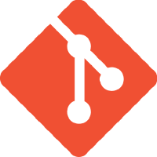

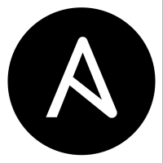
Question 2
How do you use tools such as Git, Jenkins, and Ansible to automate the software development and deployment process?

Slide 5
Question 2: Answer
Git, Jenkins, and Ansible are popular tools that are used to automate various stages of the software development and deployment process in DevOps. Here is how each of these tools is typically used:
Git: Git is a version control system that helps track changes in the codebase and collaborate with other team members. It is used to store, manage, and track changes to the code throughout the development process.
Jenkins: Jenkins is a continuous integration and continuous delivery (CI/CD) platform. It is used to automate the build, test, and deployment processes. Jenkins can be integrated with Git and can automatically build and test the code whenever changes are pushed to the repository.
Ansible: Ansible is a configuration management tool that helps automate the deployment and management of applications and infrastructure. It can be used to automate the provisioning and configuration of servers, as well as to deploy applications. With Ansible, teams can define the desired state of their infrastructure and the tool will make sure it stays in that state.
By using these tools together, teams can automate many manual and time-consuming tasks, freeing up time to focus on more critical work. Additionally, the use of automation helps to reduce the risk of errors and improve the speed and reliability of the software delivery process.
Interview Summary Answer:
In DevOps, Git, Jenkins, and Ansible are widely used tools to automate various stages of the software development and deployment process. Git is a version control system for tracking code changes, Jenkins is a CI/CD platform for automating the build, test, and deployment processes, and Ansible is a configuration management tool for automating the deployment and management of applications and infrastructure. By using these tools together, teams can improve efficiency and reliability in the software delivery process.

Slide 6

Question 3
Can you walk me through a recent project you managed using DevOps practices and the challenges you faced?

Slide 7
Question 3: Answer
Interview Summary Answer:
Recently, I had the opportunity to lead a team in developing and deploying a business inventory organizer application. During the project, we adopted DevOps practices to streamline the development and deployment process. One of the key tools we used was Jira, which helped us manage and track the project effectively. We utilized its issue/task management, roadmaps, and project backlog features to divide and organize the workload among the team members.
One of the main challenges we faced was getting used to the vast number of tools available in DevOps and becoming familiar with the setup process. Jira, being a powerful tool, provided many options that could sometimes be overwhelming. However, we took a systematic approach and used Jira's built-in features to prioritize tasks, assign responsibilities, and monitor progress. This allowed us to maintain a balance between the useful and necessary information, leading to a successful completion of the project.
Notes:
While going through Jump training course I had the opportunity to lead a group to develop and deploy an application that was designed to be a business inventory organizer. During that process we used Jira to help manage/ track the project. Being able to utilize its built in features like issue / task management tools, roadmaps and project backlogs really helped the team divide and organize the workload of the project.
The main challenges faced were getting used to the large amount of tools available and becoming familiar with how to set up the DevOps software. Jira is a very power full tool that provides many options to help manage a team/project and at times it can be difficult to balance what is useful and what is needed.

Slide 8
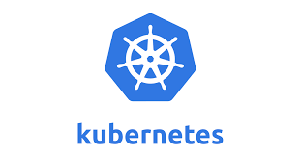
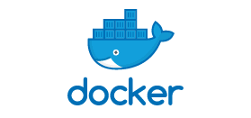
Question 4
How do you use containerization and orchestration technologies, such as Docker and Kubernetes, to improve scalability and reliability?

Slide 9
Question 4: Answer
Containerization and orchestration technologies, such as Docker and Kubernetes, can greatly improve scalability and reliability in DevOps.
Docker allows developers to package an application and its dependencies into a container, making it portable and easy to deploy.
Kubernetes is an orchestration platform that automates the deployment, scaling, and management of containers.
With Kubernetes, containers can be easily deployed and managed as a group, allowing for high availability and automatic failover.
The use of containerization and orchestration technologies allows teams to easily scale their applications up or down based on demand, ensure consistent performance across different environments, and increase reliability by providing features such as automatic failover.
Interview Summary Response:
Containerization and orchestration technologies, such as Docker and Kubernetes, play a crucial role in improving scalability and reliability in DevOps. Docker enables developers to package an application and its dependencies into a portable container, while Kubernetes automates the deployment, scaling, and management of these containers. With these technologies, applications can be easily scaled up or down based on demand, performance is consistently maintained across different environments, and reliability is increased through features such as automatic failover. These benefits ultimately help to ensure a smooth and efficient software delivery process.

Slide 10


Question 5
Can you explain how you use monitoring and logging tools, such as Prometheus and ELK, to improve visibility and troubleshoot issues in a production environment?

Slide 11
Question 5: Answer
In a production environment, monitoring and logging tools such as Prometheus and ELK are essential for improving visibility and troubleshooting issues.
Prometheus is a popular open-source monitoring tool that allows teams to collect and store metrics from their applications and infrastructure. It provides real-time visibility into the performance and health of systems and enables teams to quickly identify and resolve issues.
ELK, which stands for Elasticsearch, Logstash, and Kibana, is a log analysis platform that provides centralized logging and visualization of log data. ELK collects logs from various sources, processes and normalizes the data, and stores it in a centralized location where it can be searched, analyzed, and visualized. This enables teams to quickly find and resolve issues and improve the overall reliability and performance of their systems.
By using these monitoring and logging tools, teams can gain real-time insights into the performance and health of their systems, quickly identify and resolve issues, and continuously improve the reliability and performance of their applications.
Interview Summary Response:
In a production environment, monitoring and logging tools play a critical role in improving visibility and resolving issues. I typically use tools such as Prometheus for real-time monitoring and alerting, and ELK for centralized logging and data visualization. Prometheus enables me to collect and store metrics from my applications and infrastructure, and quickly identify and resolve any issues that arise. ELK provides a centralized repository for logs and allows me to easily search, analyze, and visualize log data. These tools help me to proactively monitor the performance and health of my systems, quickly identify and resolve issues, and continuously improve the reliability and performance of my applications.

Slide 12
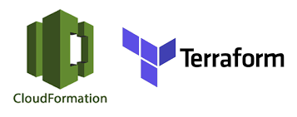
Question 6
How do you handle and manage infrastructure as code using tools such as Terraform or CloudFormation?

Slide 13
Question 6: Answer
Infrastructure as code (IAC) is a DevOps practice that enables teams to manage and provision their infrastructure using code and automated tools. This helps to improve the consistency, repeatability, and scalability of infrastructure management processes.
Terraform and CloudFormation are two popular IAC tools that allow teams to define, manage, and version their infrastructure as code.
With Terraform, teams can define their infrastructure as code using Terraform HashiCorp Configuration Language (HCL) and manage infrastructure resources across multiple cloud providers and on-premise environments.
Terraform allows teams to define the desired state of their infrastructure and the tool will automatically create, modify, and delete resources to ensure that the infrastructure stays in that state.
CloudFormation, on the other hand, is a native AWS tool for managing AWS resources. It allows teams to define their AWS infrastructure as code using JSON or YAML templates and manage resources through the CloudFormation service.
CloudFormation can be used to automate the creation, update, and deletion of resources within an AWS environment.
By using IAC tools like Terraform and CloudFormation, teams can improve the consistency, repeatability, and scalability of their infrastructure management processes, reduce the risk of manual errors, and ensure that their infrastructure stays in the desired state over time.
Interview Summary Answer:
In DevOps, Infrastructure as Code (IAC) is a key practice that helps teams manage and provision their infrastructure using code and automated tools. I have experience using IAC tools such as Terraform and CloudFormation to define and manage infrastructure as code. With Terraform, I have defined infrastructure using Terraform HashiCorp Configuration Language (HCL) and managed resources across multiple cloud providers and on-premise environments. With CloudFormation, I have defined AWS infrastructure as code using JSON or YAML templates and managed resources through the CloudFormation service. By using IAC, I have been able to improve the consistency, repeatability, and scalability of infrastructure management, reduce manual errors, and ensure that the infrastructure stays in the desired state over time.

Slide 14
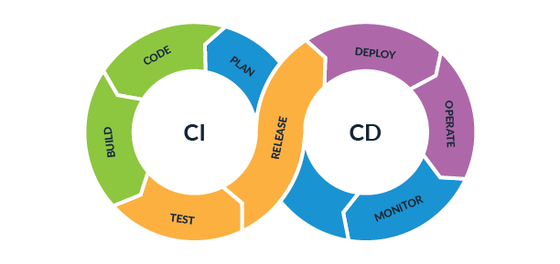
Question 7
Can you discuss your experience with continuous integration and delivery (CI/CD) pipelines?

Slide 15
Question 7:Answer
Yes, I have experience working with CI/CD pipelines. CI/CD is a crucial aspect of DevOps that enables teams to automate the build, testing, and deployment of software. I have worked with CI/CD tools such as Jenkins and Sonarqube to set up automated pipelines that integrate with the source code repository and perform various stages of the software development process, such as compiling code, running tests, building and deploying artifacts, and more.
I have also worked with scripting languages such as Bash and Python to automate various tasks and enhance the functionality of CI/CD pipelines. Additionally, I have experience integrating CI/CD pipelines with other tools and services such as deployment tools, monitoring tools, and container orchestration platforms to streamline the software delivery process. By using CI/CD pipelines, I have been able to improve the speed, quality, and reliability of the software development and deployment process.
Interview Summary Answer
Yes, I have experience working with CI/CD pipelines and have used tools like Jenkins and Sonarqube to set up automated processes for building, testing, and deploying software. I have also worked with scripting languages to enhance pipeline functionality and have integrated pipelines with other tools and services for streamlined software delivery. My experience with CI/CD has helped me improve speed, quality, and reliability in the software development and deployment process.

Slide 16


Question 8
How do you use tools such as JIRA or Trello to manage and track work in a DevOps environment?

Slide 17
Question 8: Answer
In a DevOps environment, tools like JIRA and Trello are used to manage and track work by providing a centralized platform for team members to collaborate, plan, and organize tasks.
They can be used to manage everything from the development of new features to the resolution of production issues.
JIRA and Trello allow teams to create and prioritize tasks, assign them to team members, set deadlines, and track progress.
They also provide reporting and visualization capabilities, making it easy to see what work has been completed, what is in progress, and what is yet to be done.
These tools also provide transparency into the development process and allow team members to communicate and collaborate effectively, reducing the risk of miscommunication and increasing overall efficiency.
I have used both JIRA and Trello to manage work in DevOps projects, and they have proven to be valuable tools for ensuring smooth and effective collaboration and tracking of work.
Interview Summary Answer
In my experience, I have used tools like JIRA and Trello in DevOps projects to manage and track work. They provide a centralized platform for team collaboration and allow us to create, prioritize, and track tasks, as well as communicate and coordinate effectively. These tools have been instrumental in ensuring a transparent development process and reducing the risk of miscommunication.

Slide 18
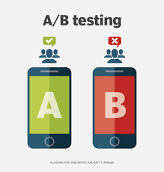
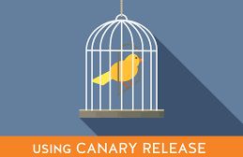
Question 9
Can you explain how you use A/B testing and canary releases to minimize risk and improve the release process?

Slide 19
Question 9: Answer
In DevOps, A/B testing and canary releases are important techniques for minimizing risk and improving the release process.
A/B testing is a process of comparing two different versions of a software feature to determine which version performs better. By releasing both versions to a subset of users, we can gather data on how users interact with each version and make informed decisions on which version to release to the general public.
Canary releases, on the other hand, involve releasing new features or changes to a small group of users before rolling it out to the general public. This helps us to detect any potential issues or failures before they impact a large number of users. This way, we can identify and fix problems before they become major incidents, reducing the risk of downtime and ensuring a smoother release process.
Both A/B testing and canary releases are effective methods for improving the quality and reliability of our software releases and minimizing risk for our users.
Interview Summary Answer
In my experience with DevOps, I have used A/B testing and canary releases as strategies to minimize risk and improve the release process. A/B testing involves releasing a new feature to a small subset of users and comparing its performance to the existing version, while canary releases involve gradually rolling out a new feature to a larger audience. These approaches allow me to test and validate new changes in a controlled environment before fully releasing them to the production environment, reducing the risk of impacting the user experience or introducing bugs. By using A/B testing and canary releases, I can continuously improve the release process and ensure the highest quality software is delivered to users.

Slide 20

Question 10
How do you foster a culture of collaboration, automation, and continuous improvement within a DevOps team?

Slide 21
Question 10: Answer
To foster a culture of collaboration, automation, and continuous improvement in a DevOps team, I would focus on the following practices:
Encourage open communication: Create an environment where team members feel comfortable discussing challenges and proposing solutions.
Emphasize collaboration: Encourage collaboration between developers and operations teams and break down silos between departments.
Prioritize automation: Invest in automation tools and processes to reduce manual work and improve efficiency.
Foster a continuous improvement mindset: Encourage the team to regularly evaluate and improve processes and tools.
Celebrate successes: Recognize and celebrate successes, both large and small, to keep team morale high and drive continuous improvement.
By prioritizing these practices, teams can foster a culture that values collaboration, automation, and continuous improvement, which can ultimately lead to better software development and delivery outcomes.
Interview Summary Answer:
To foster a culture of collaboration, automation, and continuous improvement within a DevOps team, I focus on the following:
Building trust and transparency through open communication
Encouraging cross-functional collaboration and teamwork
Providing training and support for new tools and processes
Celebrating successes and learning from failures
Continuously seeking feedback and making adjustments to improve processes
Fostering a growth mindset and encouraging experimentation and innovation.

